Slide 1


BATCH NO: K8 DOMAIN: CLOUD COMPUTING PROJECT TITLE :CLOUD COMPUTING SECURITY CHALLENGES, THREATS AND VULNERABILITIES
TYPE AND RELEVANCE OF PROJECT:
S.No. | Register Number | Name of the Student
1 | U18CS502 | THIRULOKESH N
2 | U18CS709 | DIVAGAR P
3 | U18CN257 | INBA ELAVARASAN R V
4 | U18CS504 | SURYA K S
GUIDED BY: K. ANURANJANI

Slide 2
AGENDA :
Objective.
Literature Survey
Base Paper
Existing System & Proposed System
Applications
Implementation
Conclusion & Future Enhancement
References

Slide 3
Objective:
Today data sharing and maintaining its security is major challenge. User in the data sharing system upload their file with the encryption using private key. This property is especially important to any large scale data sharing system, as any user leak the key information then it will become difficult for the data owner to maintain security of the information. In this paper provide a concrete and efficient instantiation of scheme, prove its security and provide an implementation to show its practicality. There are lots of challenges for data owner to share their data on servers or cloud. There are different solutions to solve these problems. These techniques are very much critical to handle key shared by the data owner. This paper will introduce the trusted authority to authenticate user those who have the access to the data on cloud. SHA algorithm is used by the trusted authority to generate the key and that key will get share to user as well as the owner. The trusted authority module receives encrypted file using AES Algorithm from the data owner and computes hash value using MD-5 algorithm. It stores key in its database which will be used during the dynamic operations and to determine the cheating party in the system (CSP or Owner). Trusted authority send file to CSP module to store on cloud. The resulting key sets are shown to have a number of desirable properties that ensure the confidentiality of communication sessions against collusion attacks by other network nodes.

Slide 4
Literature Review
S.NO | TITLE | AUTHOR | TECHNIQUES | RESULTS | DISADVANTAGES
1 | Efﬁcient and veriﬁable outsourcing scheme of sequence comparisons | Y.Feng,H.Ma,andX.Chen | With the rapid development of cloud computing, the techniques for securely outsourcing prohibitively expensive computations are getting widespread attentions in the scientific community. | our proposed solution enables clients to efficiently detect the misbehaviour of dishonest servers. Furthermore, our construction re-garbles the circuit only for malformed responses and thus is very efficient for real-world applications. Besides, we also present the formal analysis for our proposed construction. | Very reliant on user input for correct identification of oxPTMs, otherwise false positives and negatives occur.

Slide 5
Cont.
S.NO | TITLES | AUTHOR | TECHNIQUES | RESULTS | DISADVANTAGES
2 | Secure outsourcing of sequence comparisons | M. J. Atallah and J. Li | With the advent of cloud computing, secure outsourcing techniques of sequence comparisons are becoming increasingly valuable, especially for clients with limited resources. One of the most critical functionalities in data outsourcing is verifiability. | In particular, our construction re-garbles the circuit only for malformed responses and hence is very efficient. Besides, we also present the formal analysis for our proposed construction. | limitation of the techniques in that they do not extend to the present situation where the strings are of different length and insertions and deletions are part of the definition.

Slide 6
Cont.
S.NO | TITLE | AUTHOR | TECHNIQUES | RESULTS | LIMITATIONS
3 | Secure and private sequence comparisons | M. J. Atallah, F. Kerschbaum, and W. Du | Here we are using Wagner-Fischer technique. | g the results of the comparisons. One way to avoid this problem is to do the following before performing the above-mentioned naive minimum finding protocol. | a limitation of the techniques in [4] that they do not extend to the present situation where the strings are of different length and therefore insertions and deletions have to be allowed.

Slide 7
Cont.
S.NO | TITLE | AUTHOR | TECHNIQUES | RESULTS | LIMITATIONS
4 | Toward a practical data privacy scheme for a distributed implementation of the Smith-Waterman genome sequence comparison algorithm | D. Szajda, M. Pohl, J. Owen, and B. Lawson | Smith-Waterman Sequence Comparison:A thorough treatment of sequence comparison techniques would (and does) fill several texts. | In practice there is flexibility in these requirements. Some applications may tolerate a few missed important results provided that a certain proportion of identified important results are generated. Others may accept some flexibility on the number of false positives, provided that no important results are missed . | This approach, in which communication is required between participants and each participant generates significant network traffic, is not currently practical due to platform limitations.

Slide 8
Base Paper
2021 6th International Conference on Inventive Computation Technologies (ICICT) | 978-1-7281-8501-9/21/$31.00 ©2021 IEEE | DOI: 10.1109/ICICT50816. 2021.9358709

Slide 9
Existing System:
Large-scale problems in the physical and life sciences are being revolutionized by Internet computing technologies, like grid computing, that make possible the massive cooperative sharing of computational power, bandwidth, storage, and data. A weak computational device, once connected to such a grid, is no longer limited by its slow speed, small amounts of local storage, and limited bandwidth: It can avail itself of the abundance of these resources that is available elsewhere on the network. An impediment to the use of “computational outsourcing” is that the data in question is often sensitive, e.g., of national security importance, or proprietary and containing commercial secrets, or to be kept private for legal requirements such as the HIPAA legislation, Gramm-Leach-Bliley, or similar laws. This motivates the design of techniques for computational outsourcing in a privacy-preserving manner, i.e., without revealing to the remote agents whose computational power is being used, either one’s data or the outcome of the computation on the data.

Slide 10
Proposed System:
We propose a secure data sharing scheme, which can achieve secure key distribution and data sharing for dynamic group. We provide a secure way for key distribution without any secure communication channels. The users can securely obtain their private keys from group manager without any Certificate Authorities due to the verification for the public key of the user. Our scheme can achieve fine-grained access control, with the help of the group user list, any user in the group can use the source in the cloud and revoked users cannot access the cloud again after they are revoked. We propose a secure data sharing scheme which can be protected from collusion attack. The revoked users can not be able to get the original data files once they are revoked even if they conspire with the untrusted cloud. Our scheme can achieve secure user revocation with the help of polynomial function. Our scheme is able to support dynamic groups efficiently, when a new user joins in the group or a user is revoked from the group, the private keys of the other users do not need to be recomputed and updated. We provide security analysis to prove the security of our scheme.

Slide 11
Applications
HARDWARE REQUIREMENTS
System - Pentium-IV
Speed - 2.4GHZ
Hard disk - 40GB
Monitor - 15VGA colour
RAM - 512MB
SOFTWARE REQUIREMENTS
Operating System - Windows XP
Coding language - Java
IDE - Net beans
Database - MYSQL

Slide 12
Implementation
METHODOLOGY
USED TOOLS
SYSTEM ARCHITECHURE
MODULES
SCREENSHOTS

Slide 13



Methodology :
AES (Advanced Encryption Standard).
MD5 Algorithm.
SHA(Secure Hashing Algorithm).

Slide 14

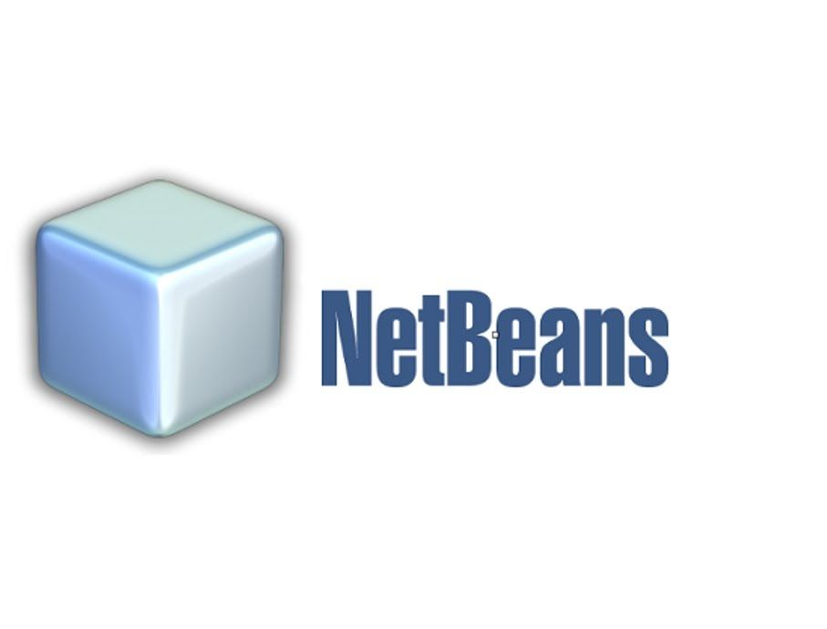
USED TOOLS

Slide 15
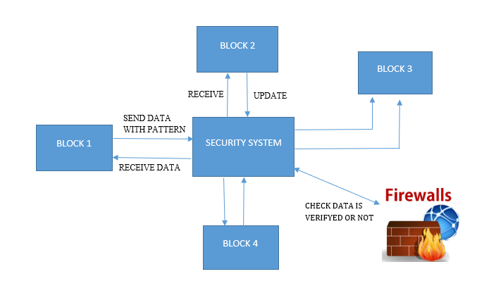
SYSTEM ARCHITECTURE

Slide 16
MODULES
Login Module
Registration Module
Creation Storage and Instance
Find collusion Module
Find Third-Party Module

Slide 17
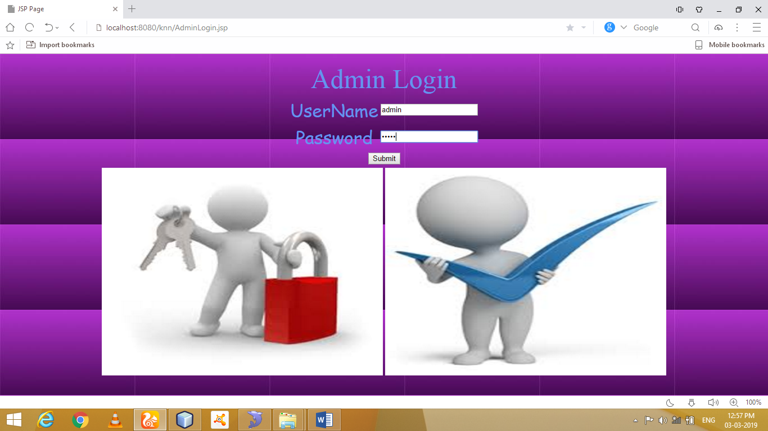
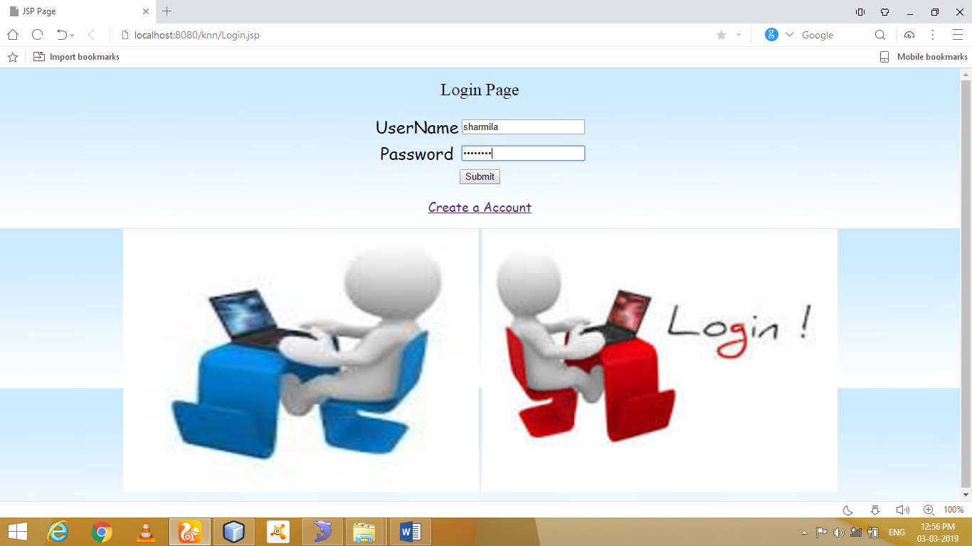
SCREENSHOTS
ADMIN LOGIN
USER LOGIN

Slide 18
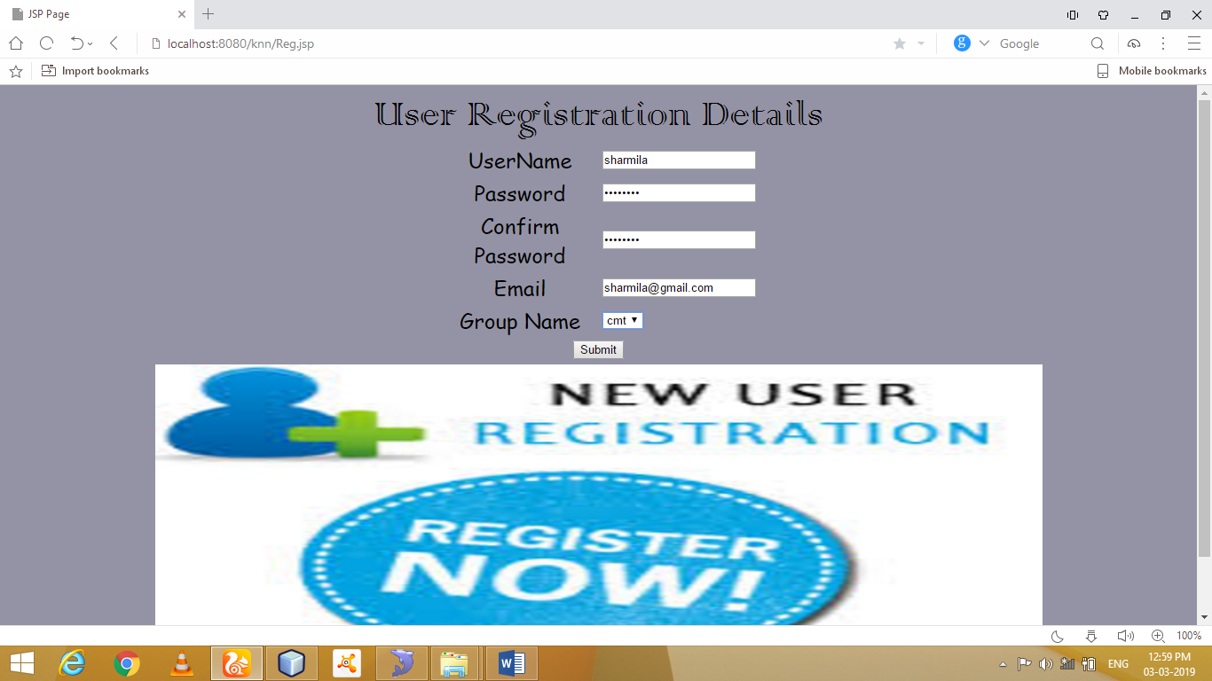
Registration

Slide 19
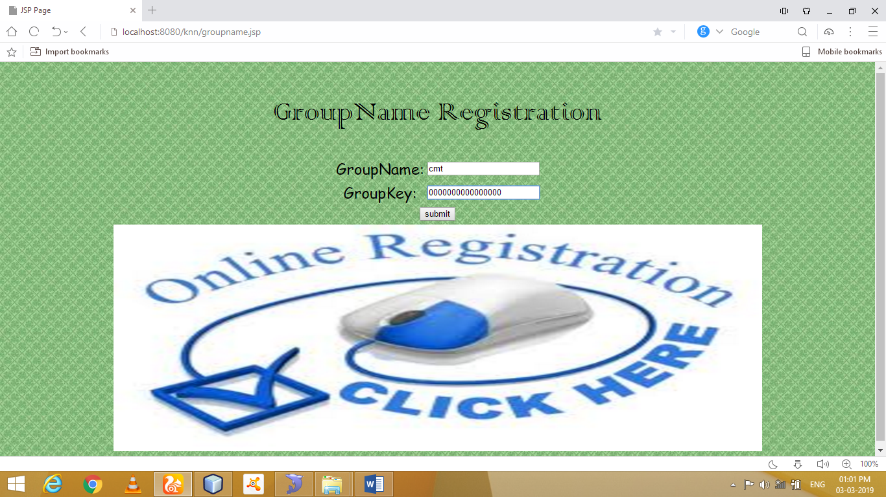
Create New Group

Slide 20
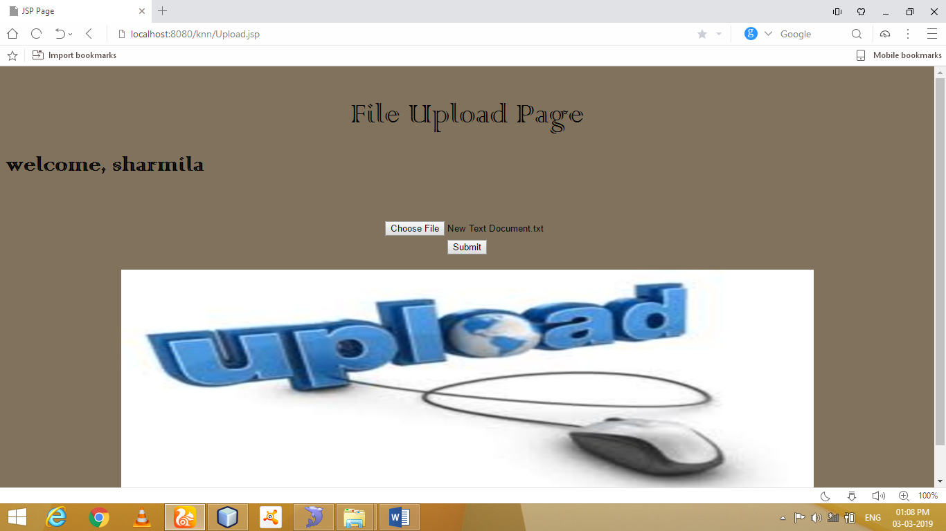
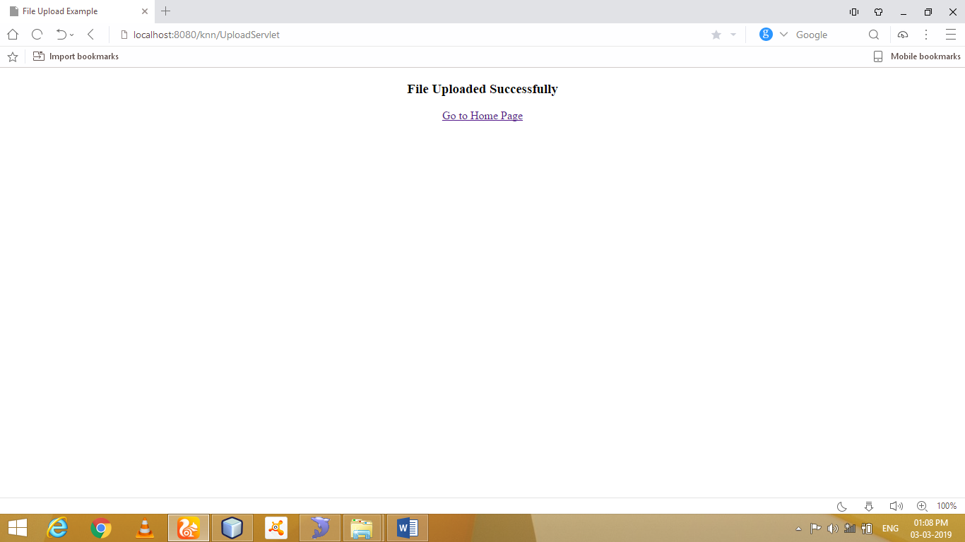
Data Upload Page

Slide 21
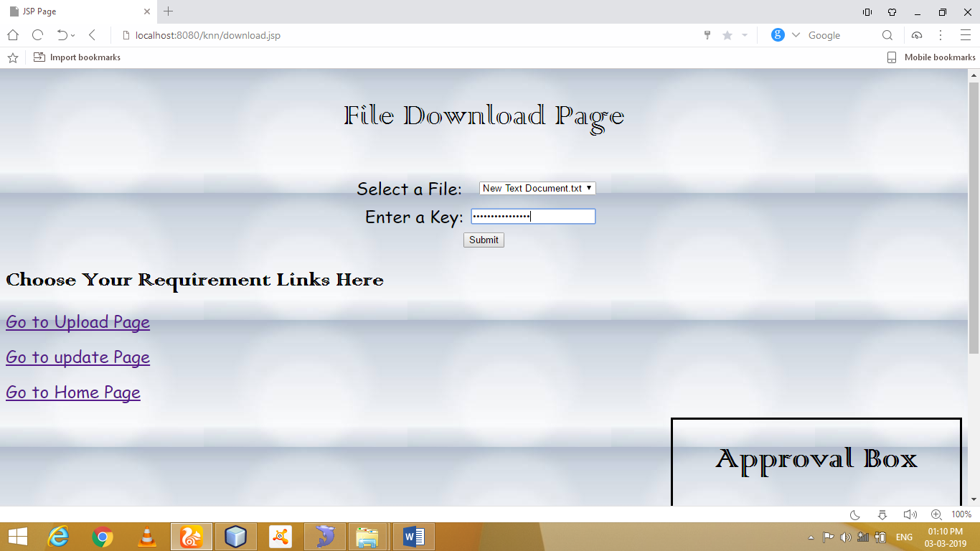
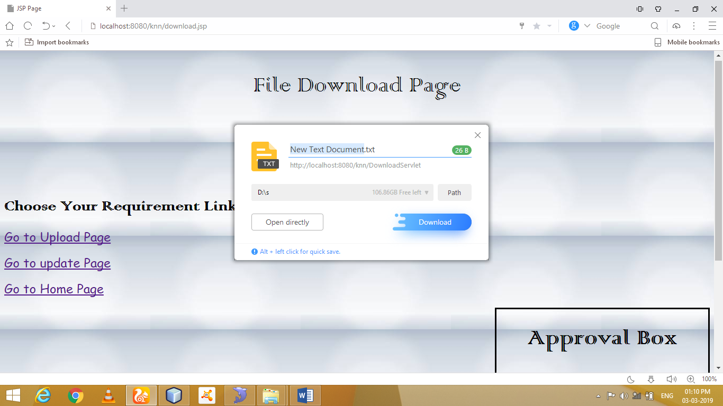
File Download Page

Slide 22
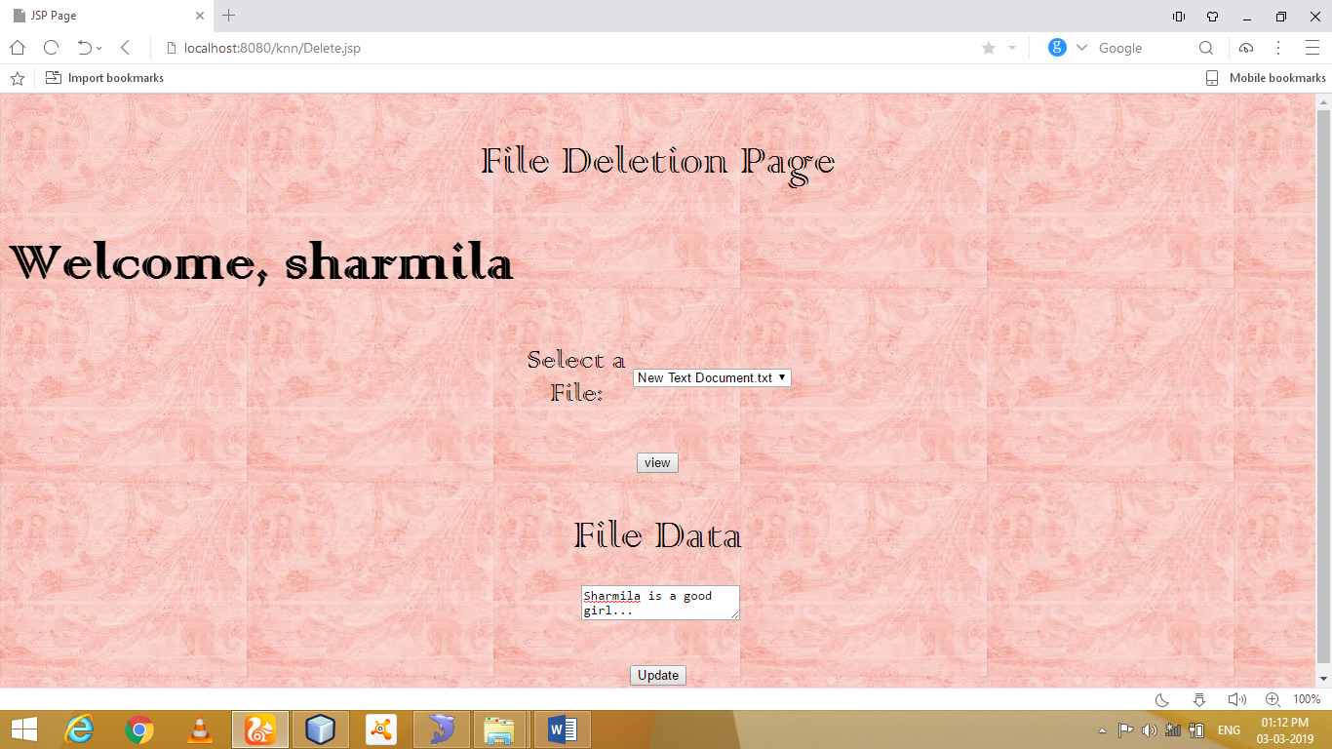
Update Page

Slide 23
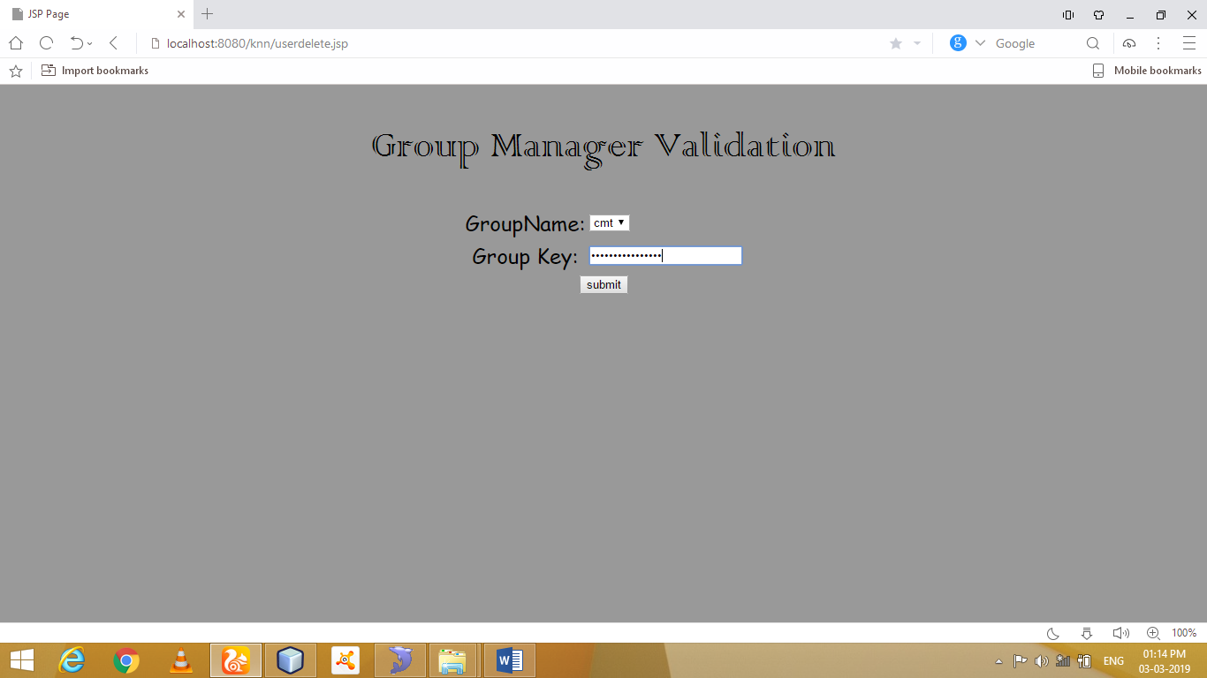
User Revocation Details

Slide 24
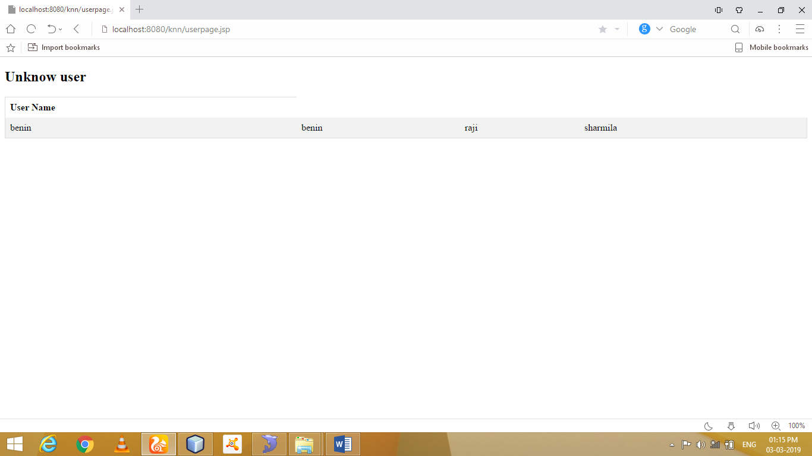
Find Third Party

Slide 25
CONCLUSION
Through the above summary, due to the problems about the collusion attacks that are widespread in the secure outsourcing of sequence comparison algorithms, this paper will introduce the trusted authority to authenticate user those who have the access to the data on cloud. SHA algorithm is used by the trusted authority to generate the key and that key will get share to user as well as the owner. The trusted authority module receives encrypted file using AES Algorithm from the data owner and computes hash value using MD-5 algorithm. It stores key in its database which will be used during the dynamic operations and to determine the cheating party in the system. Trusted authority send file to CSP module to store on cloud. The resulting key sets are shown to have a number of desirable properties that ensure the confidentiality of communication sessions against collusion attacks by other network nodes.

Slide 26
FUTURE ENHANCEMENT
It is somewhat hard to extend the work in our paper to certain applications with multi-data source. Firstly, two character sequences from different sources should be encrypted respectively with different keys. Secondly, three cost matrices should be encrypted together after being constructed by the negotiation between both sides. The security target is to complete sequence comparison on a single cloud server in the way of privacy preservation and to ensure that the string typed data of the end user on any side will not be arbitrarily stolen by the other user or the CSP.

Slide 27
REFERENCES
[1] Y.Feng,H.Ma,andX.Chen,‘‘Efﬁcient and veriﬁable outsourcing scheme of sequence comparisons,’’ Intel. Atom. Soft Compute., vol. 21, no. 1, pp. 51–63, Jan. 2015.
[2] M. J. Atallah and J. Li, ‘‘Secure outsourcing of sequence comparisons,’’ in Proc. Int. Workshop Privacy Enhancing Technol. (PET), Toronto, ON, Canada, 2004, pp. 63–78.
[3] M. J. Atallah, F. Kerschbaum, and W. Du, ‘‘Secure and private sequence comparisons,’’ in Proc. ACM Workshop Privacy Electron. Soc. (WPES), Washington, DC, USA, 2003, pp. 39–44.
[4] D. Szajda, M. Pohl, J. Owen, and B. Lawson, ‘‘Toward a practical data privacy scheme for a distributed implementation of the Smith-Waterman genome sequence comparison algorithm,’’ in Proc. Netw. Distrib. Syst. Secur. Symp. (NDSS), San Diego, CA, USA, 2006, pp. 253–265.
[5] X. Chen, J. Li, J. Ma, Q. Tang, and W. Lou, ‘‘New algorithms for secure outsourcing of modular exponentiations,’’ IEEE Trans. Parallel Distrib. Syst., vol. 25, no. 9, pp. 2386–2396, Sep. 2014.

Slide 28
THANK YOU

